Slide 1


Quickcure
“healthcare at the speed of life”

Slide 2
Problem Statement #4: The Role of Al in Healthcare
Context:
Emergency and urgent care facilities are now increasingly enabling appointments and registering ahead of arrival for a speedy experience and a heads up on long wait times. Each of these scheduling services is tied to a particular system/provider. Create an online experience where users can search Emergency Dept/Urgent Care options by zip codes for availability across provider systems. Quite simply, who close to me can see me the soonest? Develop a solution using Al.

Slide 3
The Problem
Accodring to French Ministory of Health, in 2022, a lot of patient report dissatisfaction with their hospital experience, primarily due to long wait times. Delayed teatment can lead to worsening health conditions and severe health outcomes
No efficient locating of patient → leads to longer waiting time in the hospital
Leads to increased waiting times, less effiency and an exspecially for the impatient longer waitingtime
Despite various attempts to improve hospital efficiency, patients still lack real-time information about wait times, which could help them choose the most suitable hospital.

Slide 4
Challenges
Regulations:
The General Data Protection Regulation (GDPR) in the EU places strict requirements on how personal data is collected, stored and used. This includes health data and we have to make sure, that our AI system complies with this strict regulations
Liability:
If an AI system makes a mistake by for example giving the output “it´s no severe illness and most likely XY – you can wait 10h” it can be difficult to determine who is liable
And apart from the damages on the patient, a really big PR problem –> better start with a functiong “small AI” with a lower risk for patients and business and develop it further
Hospitals:
Hospitals often use different systems which sometimes doesent even provide an interface – a solution has to be independent with no dependency in order to function with in a big scale and in various hospitals

Slide 5
Solution: Application/IT Layer
Based on geographical locations and current wait times, our software uses AI to advise the best hospital for treatment in real-time.
This offers patients the power to make knowledgeable decisions and lessens the stress related to hospital visits.
Our system calculates predicted wait times using data from RFID chips, offering highly accurate and up-to-date data.
Why RFID ? It allows us to track all Patients (also these wo don´t use the application) and allows live predictions since it knows how many people are waiting in each hospital right now!

Slide 6


Solution: Physical Layer
Waiting Room
Treatment
Patient with Pain
Treatment
Entrance/Exit
Reception
Treatment
RFID Scanner 1: stamps the time (t_{e}) and checks the person in (without any specific work from him)
RFID Scanner II: stamps the time (t_{f}) when the P. leaves the hospital
Patient (with at least a bit) less pain
Patient gets his papers + a printed RFID sticker
On the way in
RFID Scanner 1
RFID Scanner 1I
On the way out

Slide 7
Product Demo

Slide 8
Benefits
Patients:
Reduced waiting time
Faster access to medical treatment
The “right decision” for a hospital in emergency situation is made by the application
Hospitals:
Better relocation of patients
Reduced demand-peaks
more efficient way to predict the demand which leads to a better planning of ressources
Health Insurances:
Faster treatment can lead to reduced long term costs
Satisfied “customers”

Slide 9
Marketing and Sales
To who are going to sell this solution?
Stakeholders:
Hospitals : Benefit from improved patient flow and satisfaction. Can pay for the product as a subscription or one-time purchase.
Government Health Departments: Interested in improving the healthcare system. Can fund the product as part of healthcare improvement initiatives.
Insurance Companies: Aim to reduce costs and improve patient outcomes. Can pay for the product as a cost-saving measure.
Patients: Desire quick care. Can use the product as a freemium app with premium features at a cost.
Sales Strategies:
Direct Sales: Reach out to hospitals, clinics, and government health departments directly with case studies and data.
Partnerships: Collaborate with other healthcare technology companies.
Content Marketing: Write blogs, articles, and white papers about the problem your product solves.
Digital Marketing: Use SEO and social media for online visibility.
Trade Shows and Conferences: Network with potential customers and demonstrate your product.

Slide 10
Costs
What are our costs per Hospital
A pricing model depends on the customer:
Hospitals:
Setup fee 6.200€ (without a margin)
Montly or annual subscription based on the size of the hospital e.g. small 500€, large 1.000€ - or pay-as-you-use
Government Health Departments:
Same system, but through big quantities heavely discounted
Insurance Companies:
Charge for each patient (flat fee per referral or percentage of the cost savings possible)
Customers:
We could charge the customers, but an annual or monthly subscribtion wouldn´t help, since they are not facing the problem daily AND we want all people to use the app!
Physical Layer | Price in Dollar
RFID Chip | 0,19
Reader x2 | 2000
Printer | 1700
Laptop | 500
Setting up cost | 3000

Slide 11



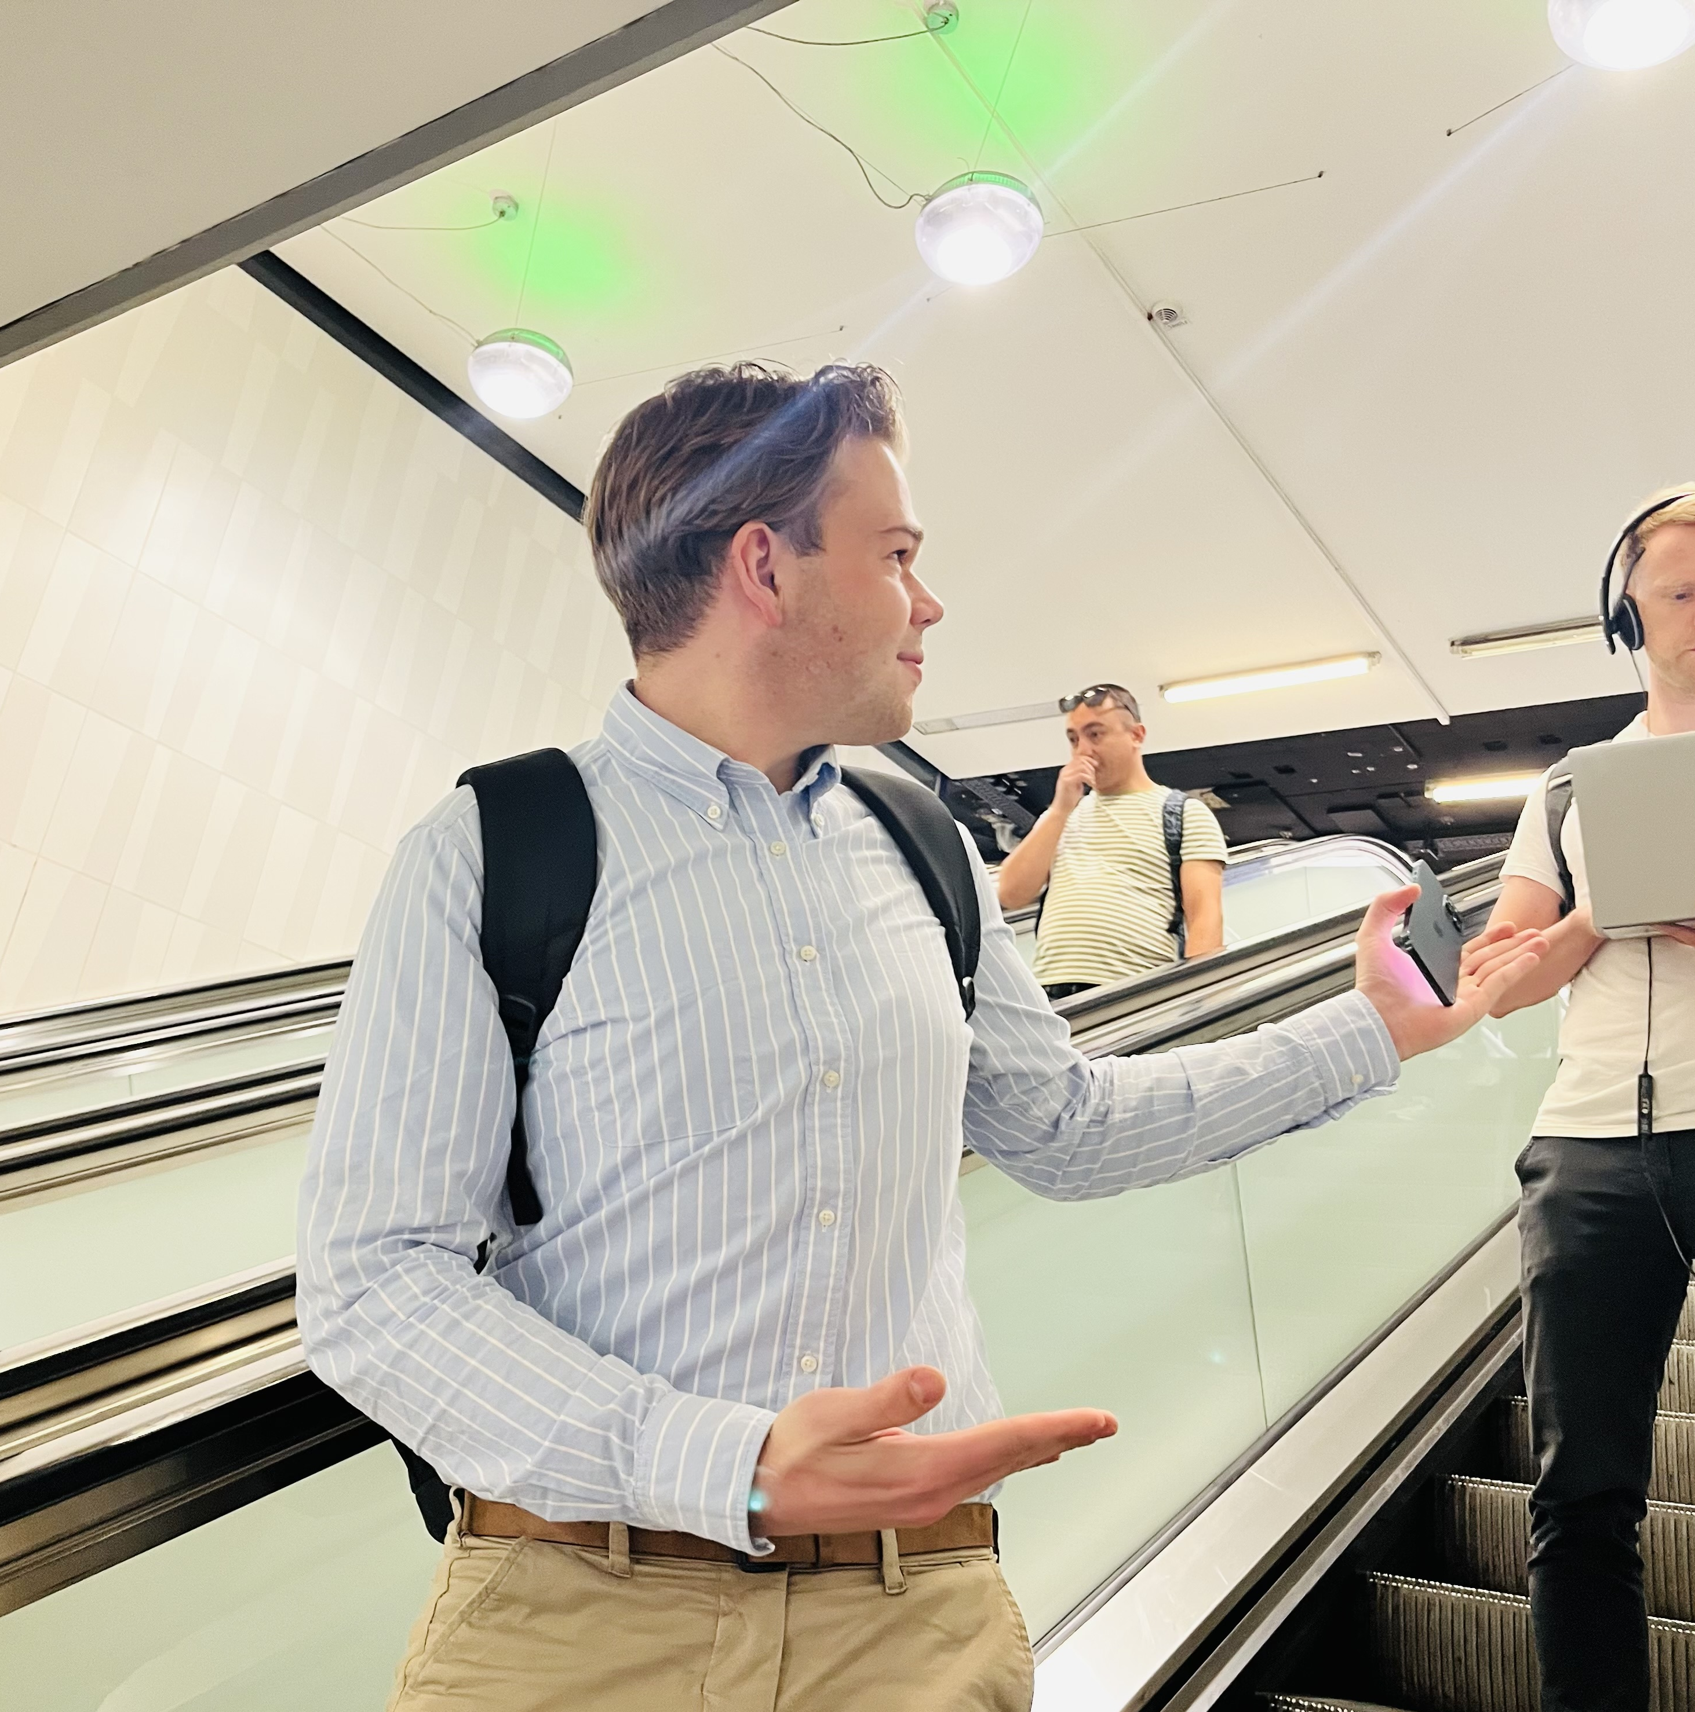
Our Team

